Slide 1
Library 4.0 era: Are academic libraries ready?
Presented by:
Biziwe Tembe, Manager: Client Services
Gold Fields Library, VUT
&
Nicolene Mkhathali, Manager: Technical Services
Gold Fields Library, VUT
4th ZULC Bennial Conference,
Harare, Zimbabwe
Date: 27th – 29th March 2019

Slide 2
Content
Introduction
Concept of the 4th Industrial Revolution
Impact of The 4th IR in academic institutions
What transpired Library 4.0?
What is Library 4.0?
Library 4.0 in academic libraries
Examples of Library 4.0 technologies
Findings from the literature
Recommendations
Conclusion

Slide 3
Introduction
Academic libraries provide access to books & space to users & also offers digital environment
Libraries are influenced by external pressures to evolve including change in IT environment
Large academic libraries use automated robots with RFID & data from the cataloguing record to retrieve and deliver books for users
This example, shows that libraries are increasingly becoming part of the 4th Industrial Revolution
Increase use of Library 4.0 style technologies & processes applied to library services for patrons

Slide 4
Concept of the 4th Industrial Revolution
The 4th IR require all enterprises to innovate in order to remain relevant & competitive on the global market
It refers to shift towards digitization, as technological advances (IoT & AI) & automation change the way we live our lives
The 4th IR resulted due to number of technologies converging in industrial operations such as: robotics, artificial intelligence, cloud computing, big data, 3D printing etc.
In 4th IR physical things become part of the internet, whether they are machines in factories, automobile or parts of the human body

Slide 5
Impact of the 4th IR in academic institutions
Universities need to adjust to global changes
Through updating their programs to capacitate the next-generation talent to meet the needs of the industry of the future
They should become a one-stop knowledge center for firms, industry associations, government agencies & community organizations
Their role not only to usher graduates into current jobs but to develop employees of the future & enable some to power next generation industries
Universities have discussions around the 4th IR

Slide 6
What transpired Library 4.0?
The 4th IR can have impact on future job prospects including librarians, due to rapid growth of technology
With new revolution, justification for existence of libraries & librarians is needed as data & information can be managed & shared in real time using artificial intelligence
To ensure that libraries remains relevant, some form of transformation is needed to face the 4th IR
In this era, libraries will offer value-added services e.g. data analysis to academics & researchers while producing students with desired quality service

Slide 7
What is Library 4.0
It is an era of Web 4.0 where libraries need to collaborate with other professional academic networks to survive
This form of collaboration becomes Library 4.0, need to be built in a virtual library environment where all library services are offered in virtual space
Some institutions are already using Library 4.0 technologies such as maker-space, Google Glass, big data, cloud computing, augmented reality etc.

Slide 8
Library 4.0 in academic libraries
MakerSpace at the University of Pretoria – Merensky Library, the unit is open to the university community
They define MakerSpace as a creative laboratory to enable people with ideas to collaborate with people who have technical ability to make ideas become reality
The space provides access to the latest technology trends such as 3D printing, 3D scanning, electronics and 3D design software
The University of Missouri Kansas City Robot – Miller Nicholas Library installed a robotic storage & retrieval system

Slide 9
Library 4.0 in academic libraries cont
The Robotic holds about 80% of the library collection, freeing up space for users.
The Library’s catalogue provides gateway to books & journals stored in the Robot
Request of these materials can be done on any computer with Internet even from home
An automatic crane will locate the requested item, deliver it to pick-up station, staff will hold the item until collected by the user
Retrieval system contains items that are occasional or little used but are easily accessible

Slide 10
Library 4.0 in academic libraries
Big data is also important in academic libraries as it is cost saving, improves enormous volumes, speed and innovative information technology
This kind of system can analyze the results of big data for planning information services suitable for the users
It indicates human interaction, communication flow and relationships among data

Slide 11
Library 4.0 in academic libraries cont
Cloud computing in library services can be applied to:
integrate management of library resources in web-based distributed surroundings
provide remote access to resources and services
encourage resource sharing amongst libraries
build comprehensive service systems
promote cooperation amongst libraries
Cloud computing is technology that is required to make big data available, while big data is available to users whenever they need via Internet connection

Slide 12
Library 4.0 in academic libraries cont
Augmented reality (AR) also known as Mixed Reality (MR) reveals real-world elements joined together with virtual ones for extra information
The system is presented for real-time interactions in 3D spaces to bring unlimited inform. into reality
VUT Science Park campus has this kind of technology, although not housed in the library
AR technology is organized into location-based augmented reality
So it can spot information where the user is looking by using directions created by other users, including image recognition augmented reality

Slide 13
Library 4.0 in academic libraries cont
In the library augmented reality technology suggest a system that:
allow users seeking information & trying to locate books an indication that will guide them to that location when searching the catalog
Many universities including VUT library are using RFID technology, such as:
Library Security Gate system
Self-check in & self-check out system
It is anticipated that Library 4.0 will incorporate many of the same concepts & technologies of Web 4.0

Slide 14
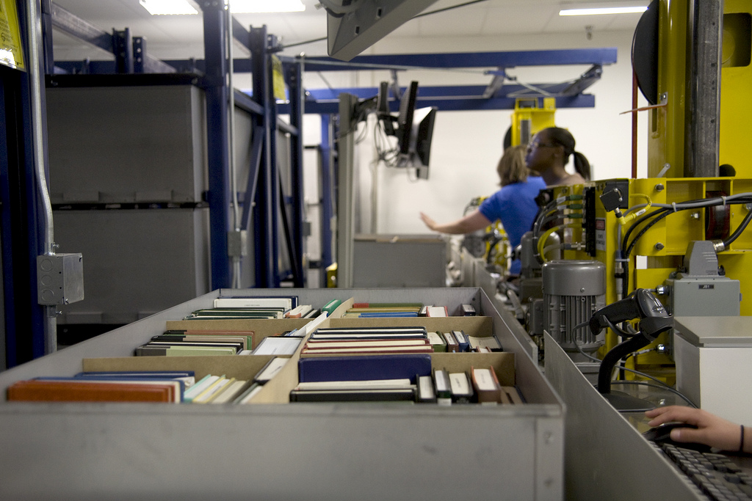
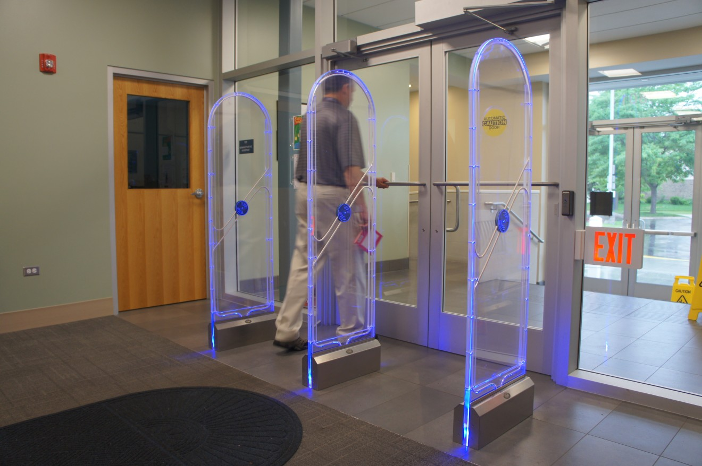
Examples of Library 4.0 technologies
UMKC Library Robot
Library security gate

Slide 15

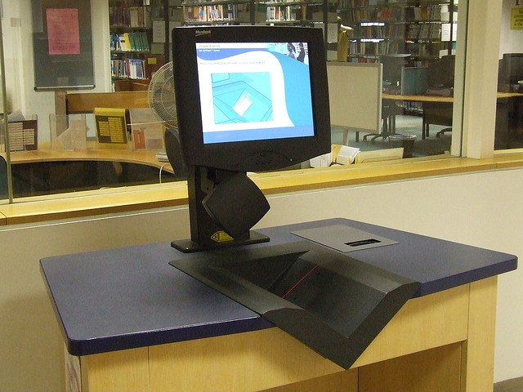
More examples…
RFID Tag
Self-checkout system

Slide 16
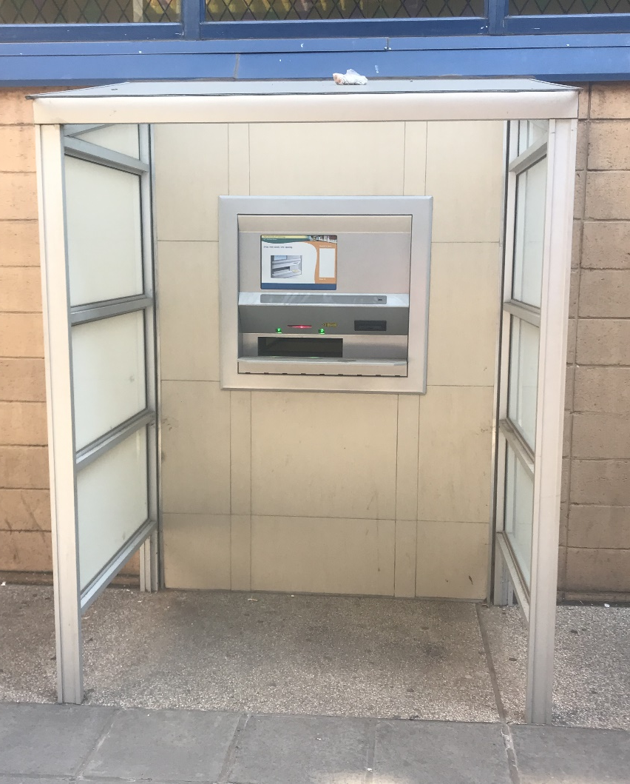
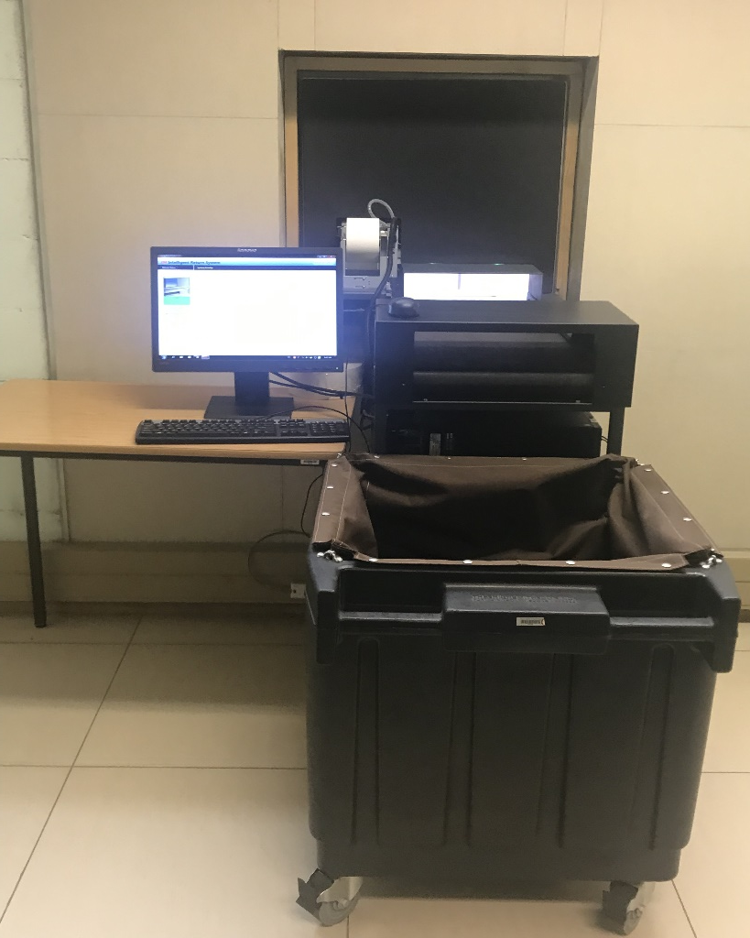
More examples…
VUT LIBRARY
SELF CHECK-IN

Slide 17
Findings from the literature
Information on Library 4.0 was scarce
Academic libraries are gradually realizing Library 4.0 era to meet demands of 21st century users
Some libraries started introducing new technologies e.g. MakerSpace, 3D printing, robots, RFID technology etc.
Library 4.0 focuses on an environment that:
allows librarians, users, and machines to coexist
technology that allows humans and machines to read, write, execute and concur at the same time
a library that thinks, makes decisions & provide library services using reasoning (intelligent library)

Slide 18
Findings from the literature
Library 2.0 pushed the role of librarians into background with advances in the search capabilities of technology
Library 3.0 librarians were helping users to locate, access & use most accurate & reliable information in various formats from many sources
Library 3.0 is seen to be intelligent & customized to a point where it is almost a living organism, sustained by the engagement of users, librarians & experts
Librarian’s role is to ensure that all concept of Library 4.0 are applicable in the library

Slide 19
Recommendations
Ongoing discussions about Library 4.0 are needed to meet the demands of future libraries
Librarians need to be proactive & be alert to emerging technologies related to libraries
To focus on detailed ways on how to apply Web 4.0 concept to libraries
Reskilling of librarians to meet challenges brought by industrial revolution
Academic libraries must be relevant in their role to stakeholders & continue to attract everyone

Slide 20
Recommendations cont…
The whole library ecosystem must transform & enjoy changes brought by the 4th IR
Academic librarians should embrace Library 4.0 and its many possibilities

Slide 21
Conclusion
What should be the role of libraries in the 4th IR?
Libraries need to bring people along pioneer to this revolution
Need to embrace technology & have the human side on it
Up-skilling is required at all levels in order to be properly prepared for this revolution
To move away from owning things but access things

Slide 22
Conclusion cont...
Librarians need to move from collection to know their connection
What do the librarians need to prepare for tomorrow?
To communicate, collaborate, creative, critical thinking

Slide 23
Thank you
Je vous remercie
Waita hako
Asante
Siyabonga

